Slide 1



Kesler Science Teacher Resource
Differentiated Learning:
Listed below are the three different modification levels used for this lab. Each lab is differentiated using the icons below. They are also included in labeled sections on the preview to the left.
Independent Inquiry: This level is the most student-centered experience. Suggestions are made for the students to get started, but most of the decisions will be student-centered. The students will be responsible for most aspects of the lab and will have the least guidance. Suggested for advanced learners.
Dependent Inquiry: This level is written with a combination of procedural instructions and inquiry questions. They are moderately student-centered with guided inquiry questions throughout the lab. Suggested for on-level learners.
Modified Inquiry: This level provides the most structured lab experience. The lessons may eliminate parts of the lab and change the questioning to include sentence stems or multiple choice questions. Suggested for learners with modifications.
CER:
Students will be using the CER model at the conclusion of the lab. The CER model includes 3 parts.
Claim – A statement that answers the original question. Usually one sentence in length. Must be specific and answer the question.
Evidence – Scientific data that supports the claim. It may include numbers but can also state observations.
Reasoning – Explanation that connects evidence to the claim. Answers “why” the evidence supports the claim. Includes science concepts by name (ex. thermal energy, chemical reaction).
YouTube Video on the CER Model. (CER - Claim Evidence Reasoning – Bozeman Science)
https://www.youtube.com/watch?v=5KKsLuRPsvU&t=346s

Slide 2


Inherited Traits Lab Teacher Directions
General:
- partners or small groups
- one, 45-minute class period
Standards:
TEKS: 7.14.C - Recognize that inherited traits of individuals are governed in the genetic material found in the genes within chromosomes in the nucleus.
Teacher Notes:
Students will be able to identify inherited traits of their classmates. In this lab, students will design a model of a DNA strand representing one gene. They will make a flowchart of a gene, DNA, chromosome, nucleus, and cell so that they understand where genetic material is found.
Materials per Group:
Red Twizzlers candy (2 pieces)
Miniature marshmallows (at least 12 per group in 4 colors: orange, pink, green, yellow) - https://amzn.to/2KuJWC8
Toothpicks (6-8)
Trait Chart (1 per person)
Additional Resources For This Topic:
Inherited Traits Complete 5E Lesson – Includes engagement activity, word wall cards, objective cards, student-led station lab, interactive notebook templates, PowerPoint, modified notes, student-choice project, homework, and assessment (including modified).
https://www.teacherspayteachers.com/Product/Inherited-Traits-and-DNA-Complete-5E-Lesson-Plan-2748482
Inherited Traits Station Lab – Includes 8 stations where students will receive new information at the input stations (Read, Watch, Explore, Research) and demonstrate understanding at the output stations (Write, Organize, Assess, Illustrate).
https://www.teacherspayteachers.com/Product/Inherited-Traits-and-Genetic-Material-Student-Led-Station-Lab-1986512

Slide 3
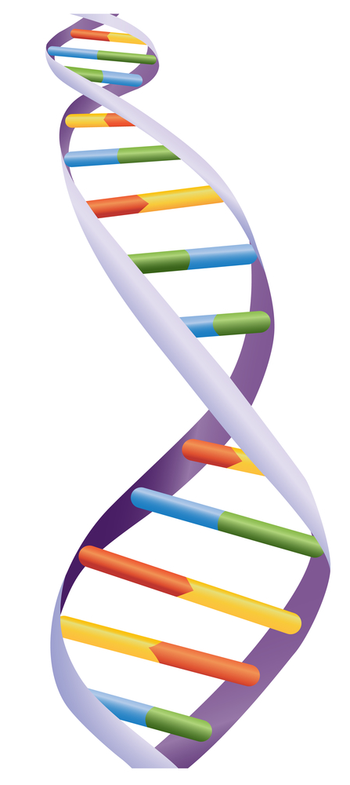
Inherited Traits Student Lab Sheet
Essential Questions:
How are individual traits determined by DNA? What is the structure of DNA, and where is it found?
Background: The ability of a cell to pass traits to its offspring is contained in the nucleus, the control center of the cell. That information is coded into something called DNA.
A DNA strand holds the blueprint for how living organisms are built. The DNA strand is made up of the 4 colored bases pictured here.
A gene is a section or segment of DNA that is passed down from parent to child and carries the trait combination from each parent to each unique offspring.
Genes are packaged in units called chromosomes. In humans, each nucleus holds 46 chromosomes (23 from each parent).
Think of it like this: DNA is the alphabet, while genes are words. Chromosomes are like books, while the nucleus is the library!
Every living creature has cells that must reproduce. In this lab, you will design a portion of a DNA strand which is also a specific gene sequence. This holds the blueprint for inherited traits.
Materials:
Red Twizzlers candy (2 pieces to represent the strands)
Several miniature marshmallows (at least 12 in 4 colors to represent the bases)
Toothpicks (6-8 to represent the bonds)
Trait Chart (1 per person)

Slide 4
Inherited Traits Student Lab Sheet
Procedure:
Using tally marks in the Traits Chart, collect data about the individual traits of each member of the class.
Check for Understanding
Look for trends in your tally of traits. How does the frequency of certain traits relate to traits being passed down from parents?
Follow the “Building a Gene” instructions to make a segment of DNA. DNA is built from pairs of bases; each marshmallow represents a type of nucleobase that is always paired with another type of nucleobase.
Nucleobase matches with → | Corresponding Nucleobase
Pink | Orange
Orange | Pink
Yellow | Green
Green | Yellow
Building a Gene
Choose a marshmallow and push it almost into the middle of a toothpick. This is one nucleobase.
Use the chart above to find the corresponding nucleobase for your marshmallow. Push this marshmallow base partner next to the first marshmallow. These two bases together are called a base pair.
Make a total of six base pairs using several combinations from the chart.
Push the toothpicks from the base pairs into the Twizzlers to form a ladder (the base pairs are the rungs and the Twizzlers are the two sides). This represents a small section of DNA, called a gene.
Gently twist the Twizzlers DNA strand into a spiral to look more like the shape of real DNA (a double helix).

Slide 5
Inherited Traits Student Lab Sheet
Traits Chart
Traits
Male
Female
Attached Earlobe
Unattached Earlobe
Right Handed
Left Handed
Hand Clasp-
Right Thumb on Top
Hand Clasp- Left Thumb on Top

Slide 6
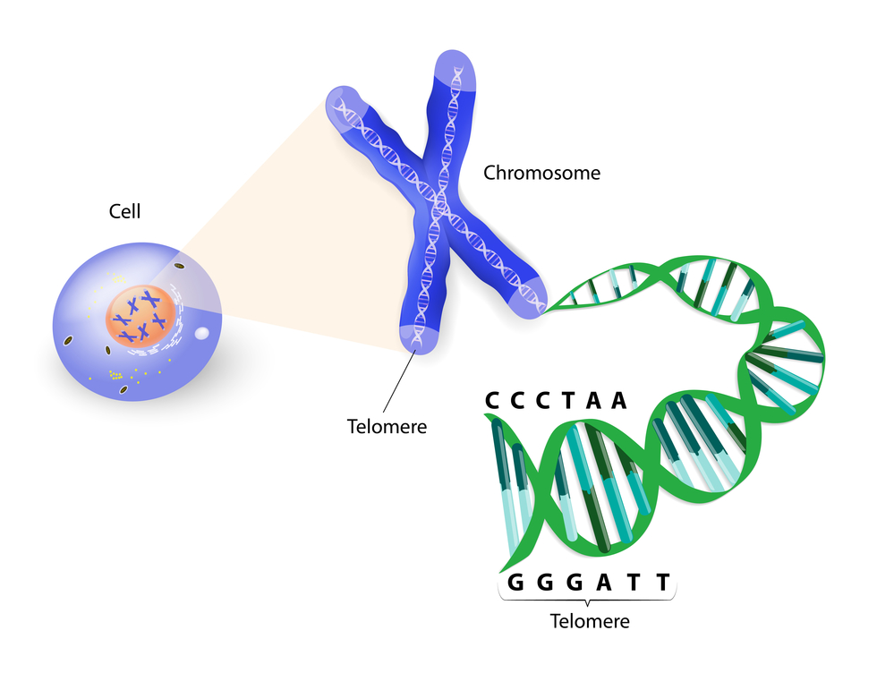

Inherited Traits Student Lab Sheet
Using the illustration to help you, draw a flow chart that puts these words in the correct order, beginning with the smallest: Cell, Nucleus, Gene, DNA, Chromosomes
Check for Understanding
Compare your “gene” model with one from another group. Would the traits passed down from these two genes be the same, or different? Why?

Slide 7
Inherited Traits Student Lab Sheet
Conclusion: How are individual traits determined by DNA? What is the structure of DNA, and where is it found?
Claim
Evidence:
Reasoning:
Reflections:
1. What genetic trait of your classmates was the most common? Do you
think this would be true in other classes?
Based on what you have learned about genetic material, why do you think everyone in your class looks different?
3. Draw a conclusion about the genetic makeup of identical twins.

Slide 8
Inherited Traits Teacher Answer Key
Procedure:
Using tally marks in the Traits Chart, collect data about the individual traits of each member of the class.
Check for Understanding
Look for trends in your tally of traits. How does the frequency of certain traits relate to traits being passed down from parents?
Some traits, like being left-handed, are rare. If few parents have a certain trait, they will only pass it down to a few children.
Follow the “Building a Gene” instructions to make a segment of DNA. DNA is built from pairs of bases; each marshmallow represents a type of nucleobase that is always paired with another type of nucleobase.
Nucleobase matches with → | Corresponding Nucleobase
Pink | Orange
Orange | Pink
Yellow | Green
Green | Yellow
Building a Gene
Choose a marshmallow and push it almost into the middle of a toothpick. This is one nucleobase.
Use the chart above to find the corresponding nucleobase for your marshmallow. Push this marshmallow base partner next to the first marshmallow. These two bases together are called a base pair.
Make a total of six base pairs using several combinations from the chart.
Push the toothpicks from the base pairs into the Twizzlers to form a ladder (the base pairs are the rungs and the Twizzlers are the two sides). This represents a small section of DNA, called a gene.
Gently twist the Twizzlers DNA strand into a spiral to look more like the shape of real DNA (a double helix).

Slide 9
Inherited Traits Teacher Answer Key
Using the illustration to help you, draw a flow chart that puts these words in the correct order beginning with the smallest: Cell, Nucleus, Gene, DNA, Chromosomes
Gene
DNA
Chromosome
Nucleus
Cell
Check for Understanding
Compare your “gene” model with one from another group. Would the traits passed down from these two genes be the same, or different? Why?
Students should recognize that if the patterns in their genes are different, the traits they pass on should be different.

Slide 10
Inherited Traits Teacher Answer Key
Conclusion: How are individual traits determined by DNA? What is the structure of DNA, and where is it found?
Claim
Traits are controlled by chromosomes, which are stored in the nucleus of a cell, and passed to offspring through the genes which are made of DNA segments.
Evidence:
In the lab, the DNA was made up of different patterns of base pairs. These base pairs made up genes, which determine what traits are passed to offspring. The reading said that the nucleus is like a library where the chromosomes are stored.
Reasoning:
DNA is a blueprint for traits that are passed to offspring. Different patterns of base pairs produce different traits. Every cell keeps DNA in chromosomes in its nucleus so each cell can pass on its own traits to its offspring.
Reflections:
1. What genetic trait of your classmates was the most common? Do you
think this would be true of other classes? Answer will vary; student should identify trends.
Based on what you have learned about genetic material, why do you think everyone in your class looks different? Students should recognize there are many patterns of DNA, and everyone has different combinations of DNA from parents.
3. Draw a conclusion about the genetic makeup of identical twins. Identical twins must share the same patterns of DNA or they wouldn’t look the same.

Slide 11
Inherited Traits Student Lab Sheet
Essential Questions:
How are individual traits determined by DNA? What is the structure of DNA, and where is it found?
Background: The ability of a cell to pass traits to its offspring is contained in the nucleus, the control center of the cell. That information is coded into something called DNA.
A DNA strand holds the blueprint for how living organisms are built. The DNA strand is made up of the 4 colored bases pictured here.
A gene is a section or segment of DNA that is passed down from parent to child and carries the trait combination from each parent to each unique offspring.
Genes are packaged in units called chromosomes. In humans, each nucleus holds 46 chromosomes (23 from each parent).
Think of it like this: DNA is the alphabet, while genes are words. Chromosomes are like books, while the nucleus is the library!
Every living creature has cells that must reproduce. In this lab, you will design a portion of a DNA strand which is also a specific gene sequence. This holds the blueprint for inherited traits.
Materials:
Red Twizzlers candy (2 pieces to represent the strands)
Several miniature marshmallows (at least 12 in 4 colors to represent the bases)
Toothpicks (6-8 to represent the bonds)
Trait Chart (1 per person)

Slide 12
Inherited Traits Student Lab Sheet
Procedure:
Using tally marks in the Traits Chart, collect data about the individual traits of each member of the class.
Check for Understanding
Look for trends in your tally of traits. Is someone in your class more likely to be right-handed or left-handed?
Follow the “Building a Gene” instructions to make a segment of DNA. DNA is built from pairs of bases; each marshmallow represents a type of nucleobase that is always paired with another type of nucleobase.
Nucleobase matches with → | Corresponding Nucleobase
Pink | Orange
Orange | Pink
Yellow | Green
Green | Yellow
Building a Gene
Choose a marshmallow and push it almost into the middle of a toothpick. This is one nucleobase.
Use the chart above to find the corresponding nucleobase for your marshmallow. Push this marshmallow base partner next to the first marshmallow. These two bases together are called a base pair.
Make a total of six base pairs using several combinations from the chart.
Push the toothpicks from the base pairs into the Twizzlers to form a ladder (the base pairs are the rungs and the Twizzlers are the two sides). This represents a small section of DNA, called a gene.
Gently twist the Twizzlers DNA strand into a spiral to look more like the shape of real DNA (a double helix).

Slide 13
Inherited Traits Student Lab Sheet
Traits Chart
Traits
Male
Female
Attached Earlobe
Unattached Earlobe
Right Handed
Left Handed
Hand Clasp-
Right Thumb on Top
Hand Clasp- Left Thumb on Top

Slide 14
Inherited Traits Student Lab Sheet
Conclusion: How are individual traits determined by DNA? What is the structure of DNA, and where is it found?
Claim
_______________ are controlled by chromosomes in the _______________ of a cell and passed to offspring through ________________ (DNA segments).
Evidence
In the lab, the _____________ was made up of different patterns of base pairs. The reading said that the nucleus is like a _________________ where the chromosomes are stored.
Reasoning:
__________ is a blueprint for traits that are passed to offspring. Every cell keeps DNA in chromosomes in its _________________ .
Reflections:
What genetic trait of your classmates was the most common? Do you think this would be true of other classes?
Based on what you have learned about genetic material, why do you think everyone in your class looks different?
Draw a conclusion about the genetic makeup of identical twins. They have the same / different genes.

Slide 15
Inherited Traits Student Lab Sheet
Essential Questions:
How are individual traits determined by DNA? What is the structure of DNA, and where is it found?
Background: The ability of a cell to pass traits to its offspring is contained in the nucleus, the control center of the cell. That information is coded into something called DNA.
A DNA strand holds the blueprint for how living organisms are built. The DNA strand is made up of the 4 colored bases pictured here.
A gene is a section or segment of DNA that is passed down from parent to child and carries the trait combination from each parent to each unique offspring.
Genes are packaged in units called chromosomes. In humans, each nucleus holds 46 chromosomes (23 from each parent).
Think of it like this: DNA is the alphabet, while genes are words. Chromosomes are like books, while the nucleus is the library!
Every living creature has cells that must reproduce. In this lab, you will design a portion of a DNA strand which is also a specific gene sequence. This holds the blueprint for inherited traits.
Procedure:
Design a way to identify at least 5 different inherited traits of your classmates.
Interview your classmates and record your information in a table.

Slide 16
Inherited Traits Student Lab Sheet
Table of inherited traits from classmates:
Check for Understanding
Look for trends in your tally of traits. How does the frequency of certain traits relate to traits being passed down from parents?

Slide 17
Inherited Traits Student Lab Sheet
DNA is built from pairs of bases; in each base pair, a certain type of nucleobase is always paired with a specific nucleobase. Look over the table of base pairs below.
Now, create a model of a segment of DNA built from base pairs. This model will represent one gene. Try to make the form as close to a double-helix as possible. Use the materials provided by your teacher.
Nucleobase matches with → | Corresponding nucleobase
guanine | cytosine
cytosine | guanine
adenine | thymine
thymine | adenine
Materials:

Slide 18
Inherited Traits Student Lab Sheet
Procedure for making a model of a DNA segment (gene) :
Check for Understanding
If you compared model genes from two different groups, would the traits passed down from these two genes be the same, or different? Why?

Slide 19
Inherited Traits Student Lab Sheet
Conclusion: How are individual traits determined by DNA? What is the structure of DNA, and where is it found?
Claim
Evidence:
Reasoning:
Reflections:
1. What genetic trait of your classmates was the most common? Do you
think this would be true of other classes?
Based on what you have learned about genetic material, why do you think everyone in your class looks different?
3. Draw a conclusion about the genetic makeup of identical twins.

